Slide 1

My Linear Relationships Interactive Notebook
Name
Class
Term 3 Semester 2

Slide 2
Contents
Formula Page
Page
Date
Description
2
3

Slide 3
Tasks
24
7
30
Essential Question
Questions
Notes
Summary
8
9

Slide 4
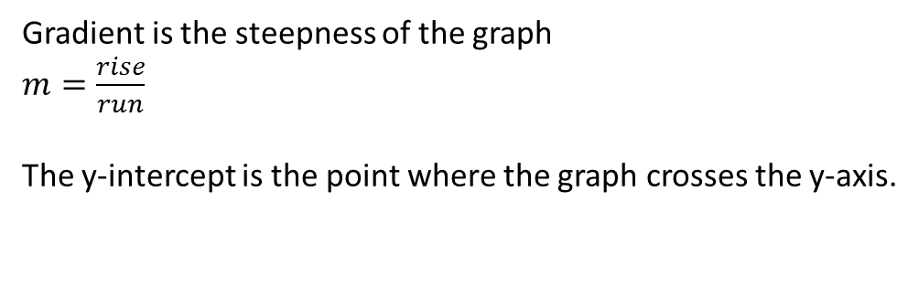
24
7
30
Date
Linear rules, Gradients and Intercepts
EQ – How can I write a linear rule using the gradient and y-intercepts?
Gradient is the steepness of the graph
$m=\frac{rise}{run}$
The y-intercept is the point where the graph crosses the y-axis.
11

Slide 5
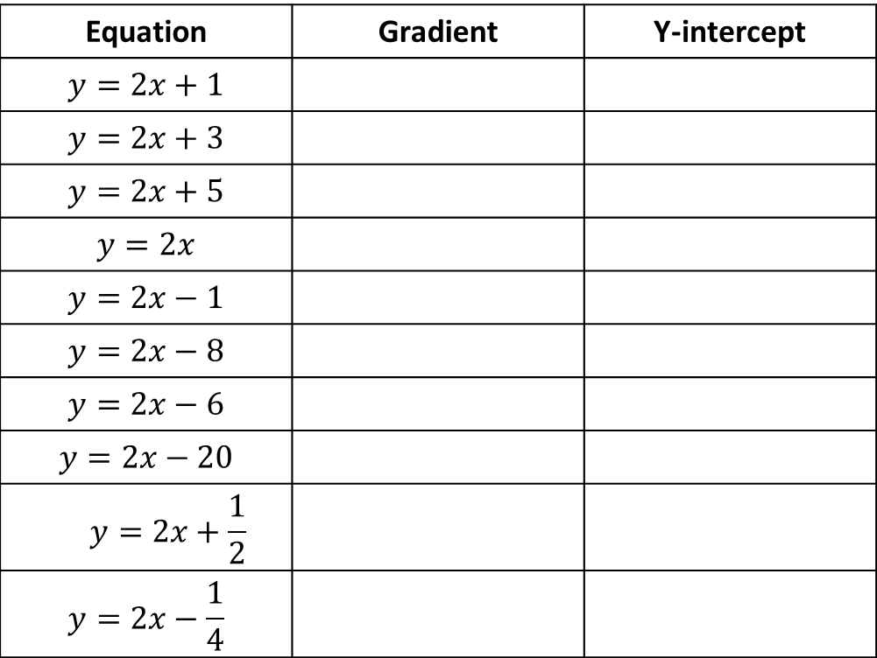
1.Copy the table onto your task page
Equation | Gradient | Y-intercept
$$y=2x+1$$
$$y=2x+3$$
$$y=2x+5$$
$$y=2x$$
$$y=2x−1$$
$$y=2x−8$$
$$y=2x−6$$
$$y=2x−20$$
$$y=2x+\frac{1}{2}$$
$$y=2x−\frac{1}{4}$$

Slide 6
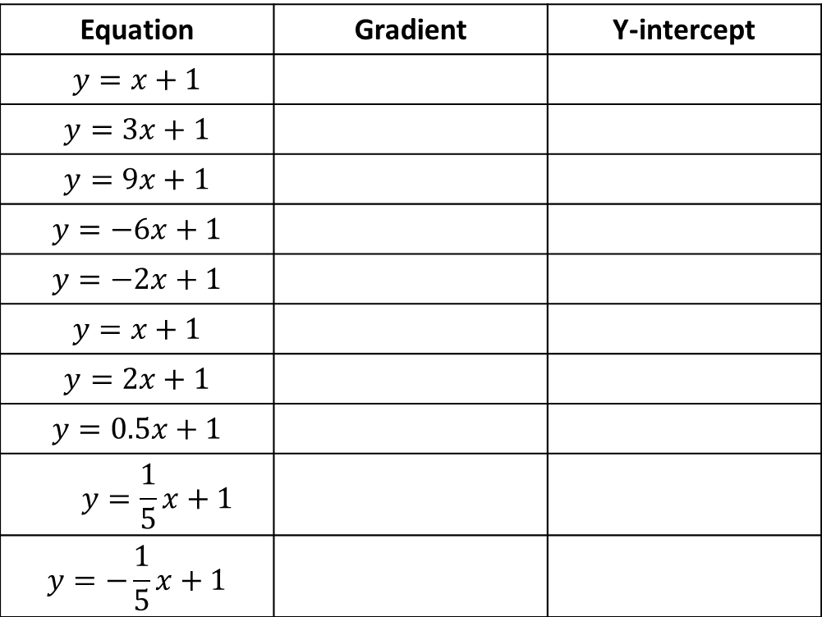
2.Copy the table onto your task page
Equation | Gradient | Y-intercept
$$y=x+1$$
$$y=3x+1$$
$$y=9x+1$$
$$y=−6x+1$$
$$y=−2x+1$$
$$y=x+1$$
$$y=2x+1$$
$$y=0.5x+1$$
$$y=\frac{1}{5}x+1$$
$$y=−\frac{1}{5}x+1$$

Slide 7
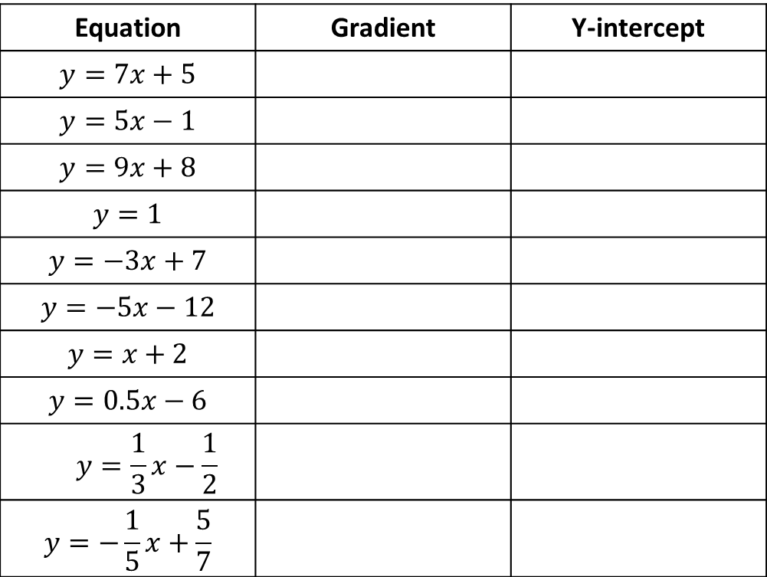
3.Copy the table onto your task page
Equation | Gradient | Y-intercept
$$y=7x+5$$
$$y=5x−1$$
$$y=9x+8$$
$$y=1$$
$$y=−3x+7$$
$$y=−5x−12$$
$$y=x+2$$
$$y=0.5x−6$$
$$y=\frac{1}{3}x−\frac{1}{2}$$
$$y=−\frac{1}{5}x+\frac{5}{7}$$

Slide 8
Questions

Slide 9
Notes Review
24, 7 ,30
Date
Title
Essential question
Notes complete
Notes complete with colour and diagrams
Questions completed
Contents page filed in
Formula page filled in

Slide 10
Homework
Review your notes and write a summary answering the essential question.

